Slide 1

Supervised Learning Algorithms
Agenda
Introduction to Supervised Learning
Simple Linear Regression
Multiple Linear Regression
Overfitting in Regression
Regularization Techniques
Regression Metrics

Slide 2

Supervised Learning Algorithms
What is Supervised Learning?
Definition: Learning from labeled data
Key characteristics: Input-output mapping, training with ground truth

Slide 3
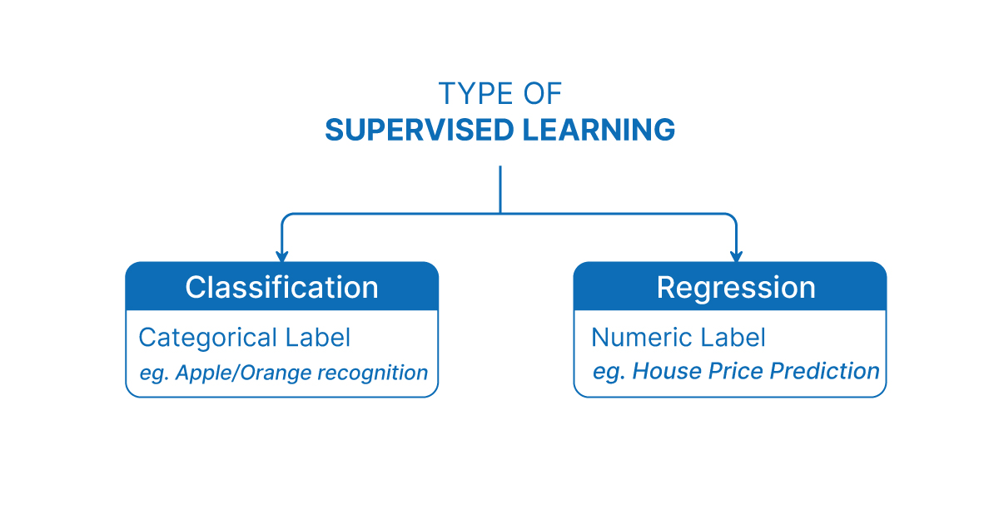
Types of Supervised Learning
Notes:
SVM seeks the straight line (in 2D) or flat plane (in higher dimensions) that clearly separates the two classes with the greatest gap between them.

Slide 4
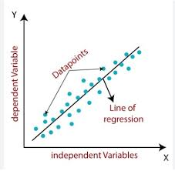
Introduction to Linear Regression
Definition: Predicting continuous values using a linear relationship
Notes:
This approach allows SVM to fit complex curves and boundaries, making it suitable for more intricate patterns in data.

Slide 5
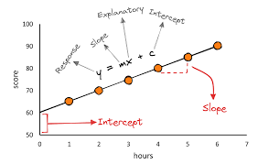
Simple Linear Regression
Formula: Y = m X + c
Example: Predicting Score based on Study Hours
Notes:
RBF kernel creates decision boundaries in non-linear spaces.

Slide 6
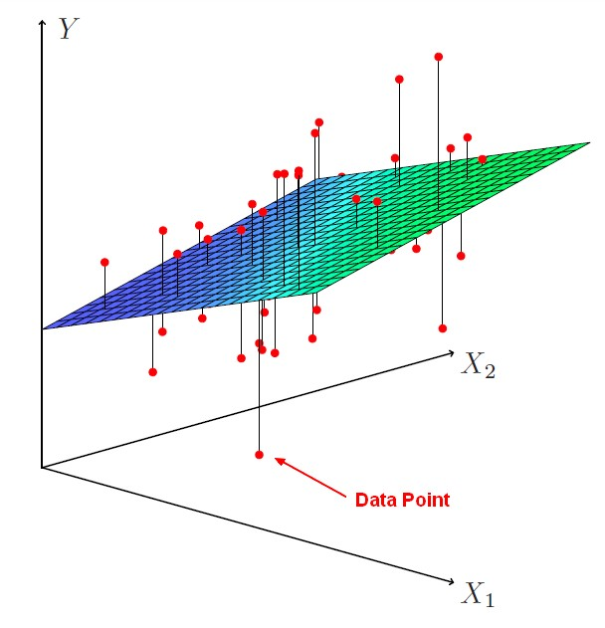
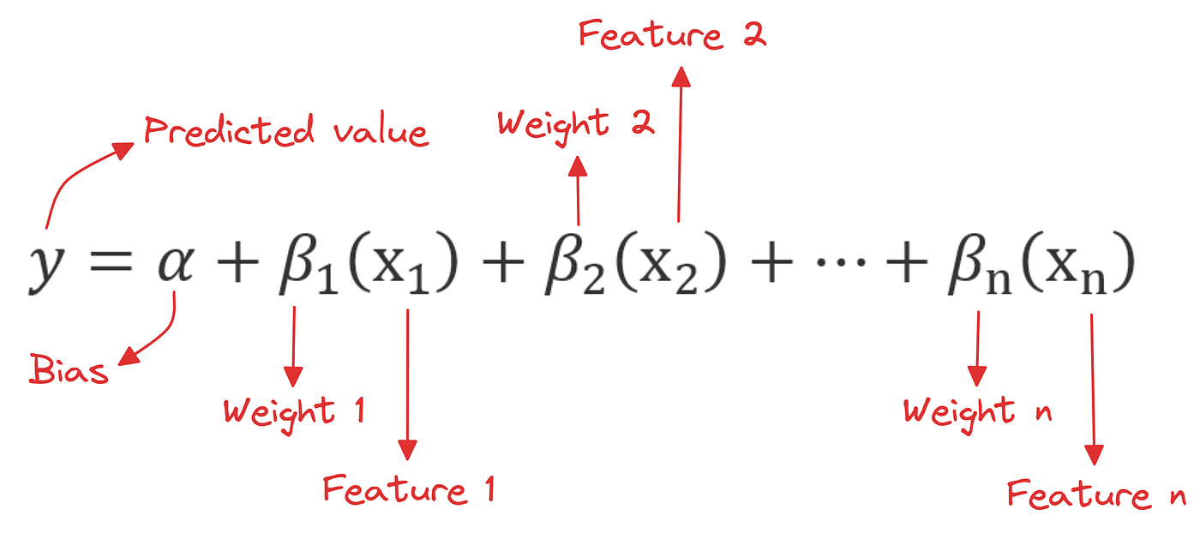
Multiple Linear Regression
Example: Predicting Life_expectancy based on GDP_per_capita, Health_expenditure, and Education_index
Notes:
SVM for classification deals with discrete categories, while SVR predicts continuous outputs.
SVR fits a function within a threshold instead of classifying.

Slide 7
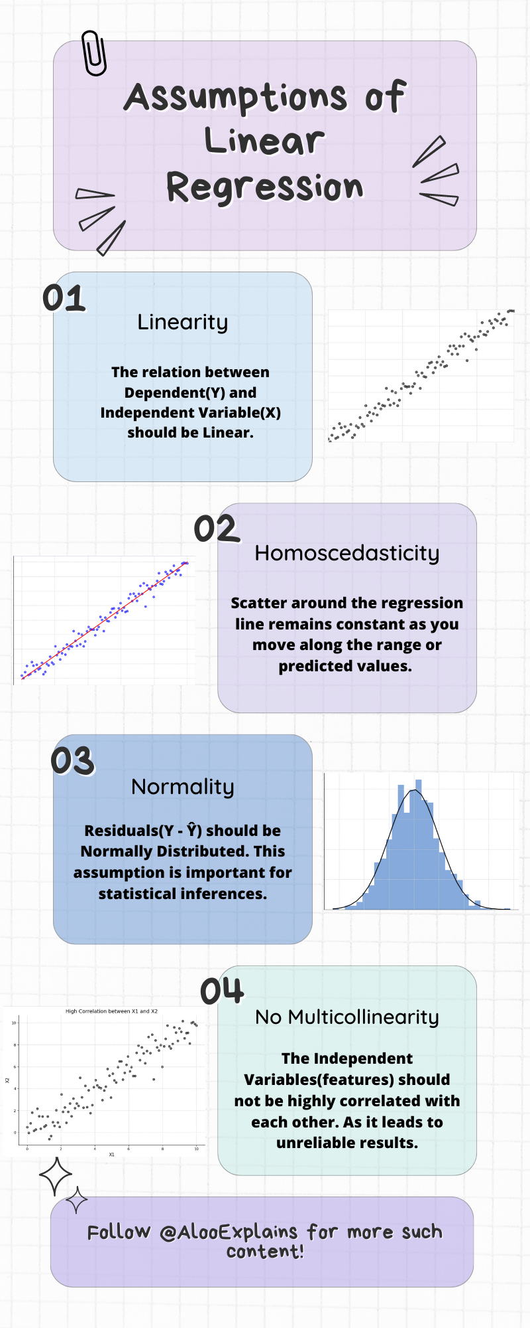
Assumptions of Linear Regression
Notes:
Highlight pros: effective on high-dimensional data, versatile kernels.
Cons: computationally expensive, especially with large datasets.

Slide 8
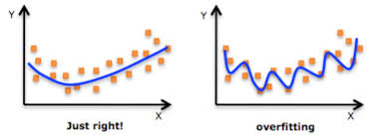
Overfitting in Linear Regression
High variance issue
Need for regularization

Slide 9

Ridge Regression (L2 Regularization)
Definition: Ridge Regression adds an L2 penalty (sum of squared coefficients) to the loss function to prevent overfitting.
Loss Function:
where λ (regularization parameter) controls the strength of the penalty.
Key Features:
✅ Reduces overfitting by shrinking coefficients towards zero but never exactly zero. ✅ Works well when many features have small but nonzero effects. ✅ Suitable when features are correlated.
When to Use?
✔ When there are many predictors in the dataset. ✔ When collinearity (correlation between features) exists.

Slide 10

Lasso Regression (L1 Regularization)
Definition: Lasso Regression adds an L1 penalty (sum of absolute values of coefficients), which leads to feature selection by forcing some coefficients to become exactly zero.
Loss Function:
where λ controls the sparsity of the model.
Key Features:
✅ Performs automatic feature selection (eliminates less important features). ✅ Helps in building sparse models (fewer features, reducing complexity). ✅ Can be used when only a few predictors are important.
When to Use?
✔ When you expect that only a few features are truly useful. ✔ When you need a more interpretable model by removing irrelevant features.

Slide 11

Elastic Net (Combination of L1 & L2)
Definition: Elastic Net is a combination of Ridge (L2) and Lasso (L1), balancing the benefits of both.
Loss Function:
where λ1​ and λ2​ control L1 and L2 penalties, respectively.
Key Features:
✅ Useful when features are highly correlated. ✅ Overcomes the limitation of Lasso (selecting only one feature from a group of correlated features). ✅ Provides a more stable and robust model.
When to Use?
✔ When there are many correlated predictors. ✔ When feature selection + coefficient shrinkage are both needed.

Slide 12
Comparison Table
Method | Regularization Type | Effect on Coefficients | Feature Selection | Best for
Ridge Regression | L2 (squared coefficients) | Shrinks coefficients but never zero | No | Multicollinearity
Lasso Regression | L1 (absolute coefficients) | Forces some coefficients to zero | Yes | Sparse models, Feature selection
Elastic Net | L1 + L2 | Combination of Ridge & Lasso | Yes | High-dimensional datasets with correlated features
By choosing the appropriate regularization technique, we can improve model performance, prevent overfitting, and handle high-dimensional data efficiently.

Slide 13

Evaluation Metrics for Regression
Mean Absolute Error (MAE)
Definition: Measures the average absolute difference between actual and predicted values.
Formula:
Characteristics: ✅ Easy to interpret. ✅ Treats all errors equally (no penalty for large errors). ❌ Does not differentiate between overestimation and underestimation.
Notes:
Information Gain = Entropy (X: before splitting) – Entropy (each feature: after splitting)

Slide 14

Evaluation Metrics for Regression
Mean Squared Error (MSE)
Definition: Measures the average squared difference between actual and predicted values.
Formula:
Characteristics: ✅ Penalizes larger errors more heavily.
✅ Helps in training models by minimizing squared errors.
❌ Sensitive to outliers due to squaring errors.
Notes:
Information Gain = Entropy (X: before splitting) – Entropy (each feature: after splitting)

Slide 15

Evaluation Metrics for Regression
Root Mean Squared Error (RMSE)
Definition: Square root of MSE; provides error in the same unit as the target variable.
Formula:
Characteristics: ✅ More interpretable since it has the same units as the dependent variable.
✅ Penalizes larger errors more than MAE.
❌ Still sensitive to outliers.
Notes:
Information Gain = Entropy (X: before splitting) – Entropy (each feature: after splitting)

Slide 16

Evaluation Metrics for Regression
R-squared (R²) – Coefficient of Determination
Definition: Measures the proportion of variance explained by the model.
Formula:
Characteristics: ✅ Ranges from 0 to 1 (higher values indicate better fit).
✅ 0 means the model does not explain any variance, 1 means a perfect fit.
❌ Adding more features always increases R², even if they are not useful.
Notes:
Information Gain = Entropy (X: before splitting) – Entropy (each feature: after splitting)

Slide 17

Evaluation Metrics for Regression
Adjusted R-squared (Adjusted R²)
Definition: Adjusted version of R² that accounts for the number of predictors in the model.
Formula:
where n is the number of data points and p is the number of predictors.
Characteristics: ✅ Penalizes unnecessary predictors that do not contribute much.
✅ Useful for comparing models with different numbers of predictors.
Notes:
Information Gain = Entropy (X: before splitting) – Entropy (each feature: after splitting)

Slide 18

Evaluation Metrics for Regression
Mean Absolute Percentage Error (MAPE)
Definition: Measures the percentage error between actual and predicted values.
Formula:
where n is the number of data points and p is the number of predictors.
Characteristics: ✅ Expresses error as a percentage, making it easy to understand.
❌ Cannot be used if actual values are zero (division by zero issue).
❌ Gives higher weight to errors in smaller values.
Notes:
Information Gain = Entropy (X: before splitting) – Entropy (each feature: after splitting)

Slide 19
Comparison of Regression Metrics
Metric | Interpretation | Strengths | Weaknesses
MAE | Average absolute error | Easy to interpret, robust to outliers | Ignores variance in errors
MSE | Average squared error | Penalizes large errors | Sensitive to outliers
RMSE | Square root of MSE | Same units as target variable | Still sensitive to outliers
R² | Proportion of variance explained | Measures goodness-of-fit | Can be misleading with too many features
Adjusted R² | R² adjusted for predictors | Penalizes unnecessary variables | Harder to interpret
MAPE | Percentage error | Scale-independent | Cannot be used when actual values are zero
Each metric serves a different purpose, and choosing the right one depends on the problem at hand.
Notes:
Information Gain = Entropy (X: before splitting) – Entropy (each feature: after splitting)

Slide 20
Thank You

